Slide 1

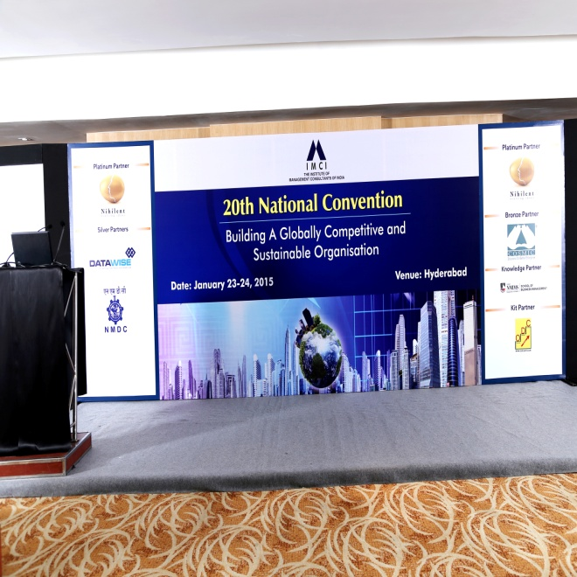
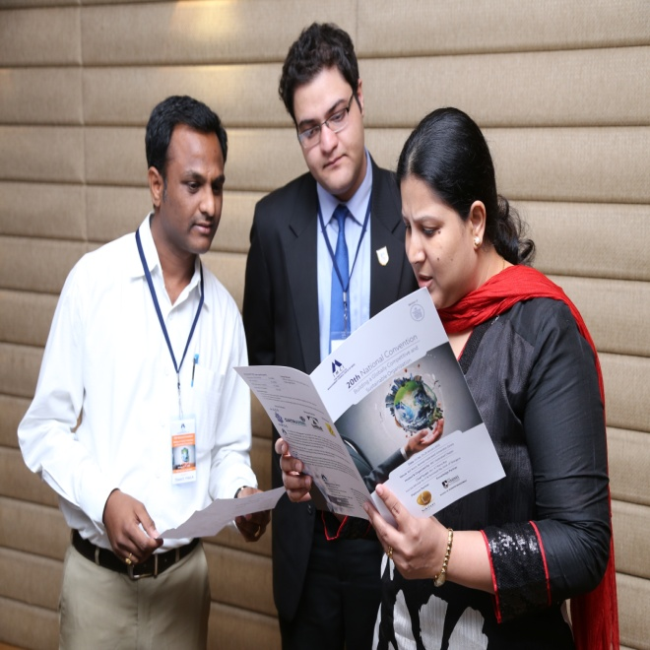
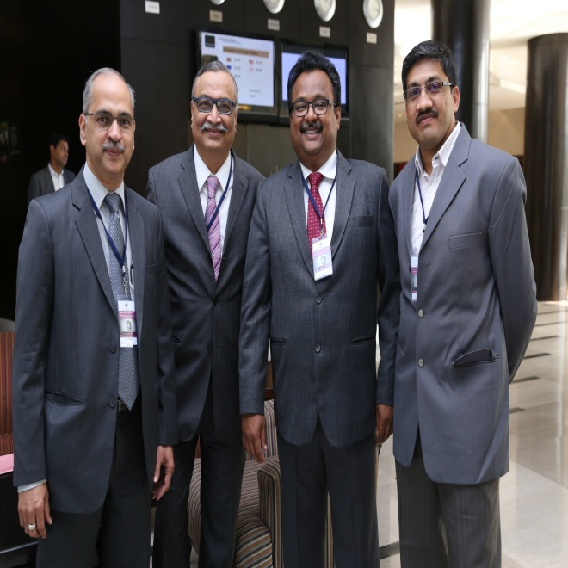
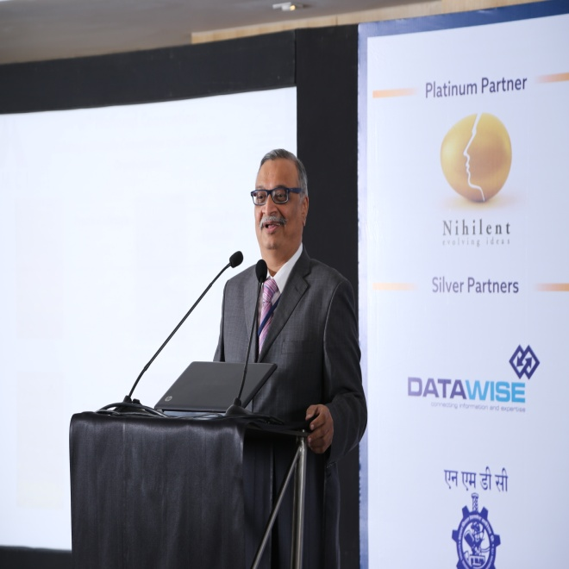
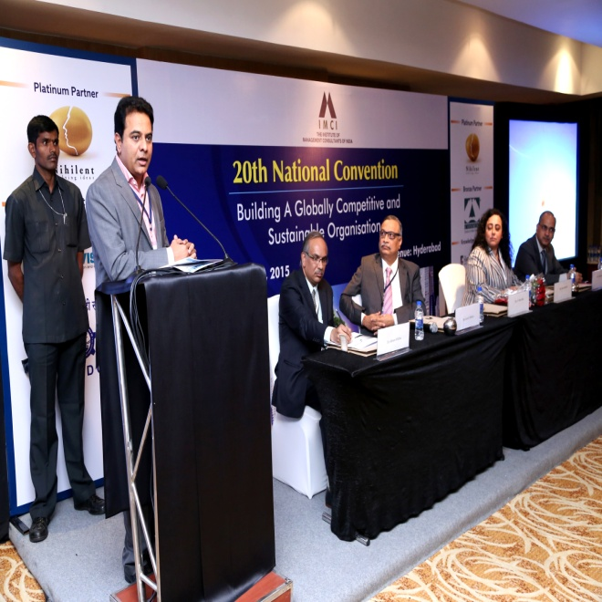
The 20th IMCI National Convention - 23rd and 24th January, 2015
From left: Mr. Vinay Kumar - Chairman, IMCI Hyderabad Chapter, Mr. Suresh Mhatre - President, IMCI, Mr. Amar Chegu - Immediate Past Chairman (Hyd) & Convention Committee Member, Mr. Shankar Chelluri - IMCI Hyderabad Chapter Member and Convention Committee Member .
Mr. Suresh Mhatre - President, IMCI, delivering his Welcome Address
Chief Guest's Address: Mr. K T Rama Rao - Hon'ble Minister for IT & Panchayat Raj (Telangana State)
Delegates going through the agenda for the day

Slide 2
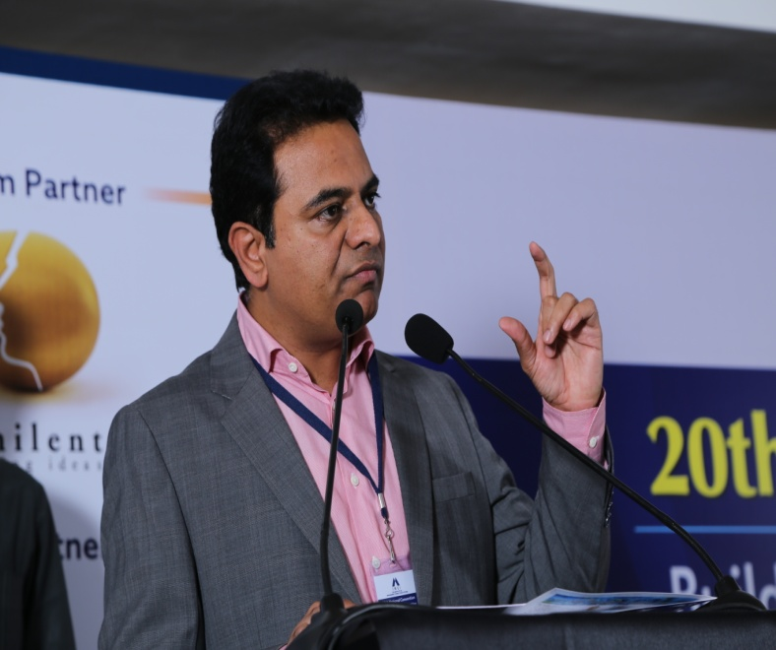
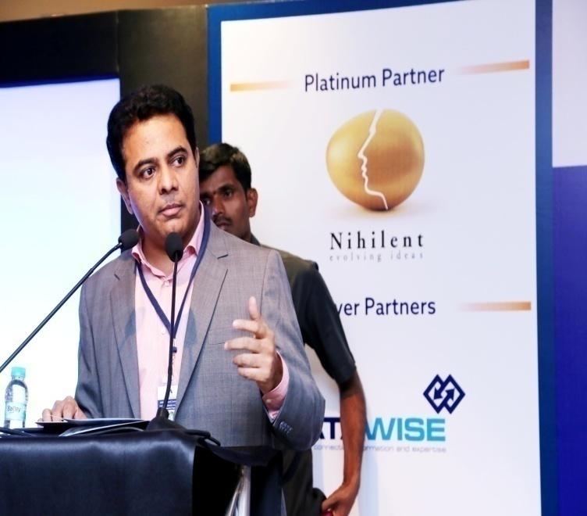
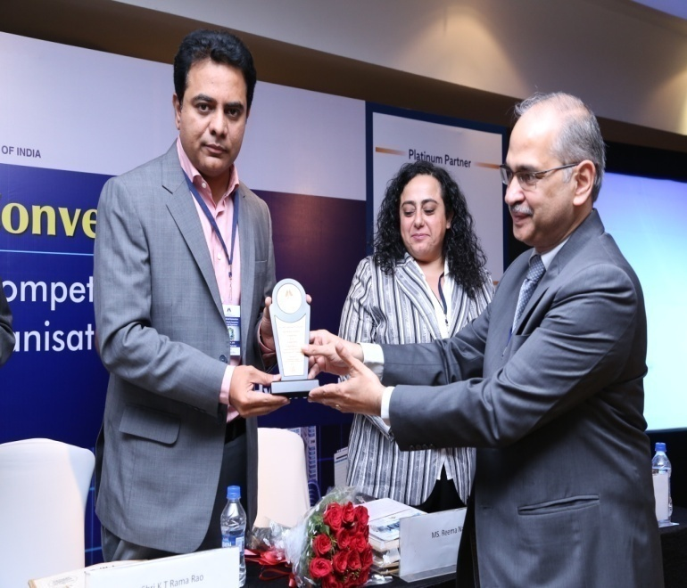
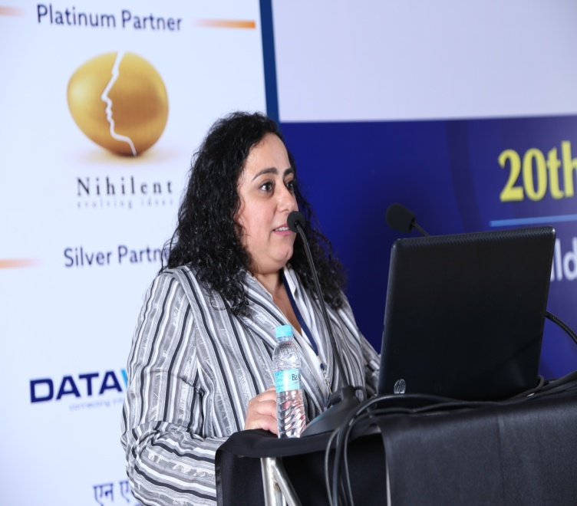
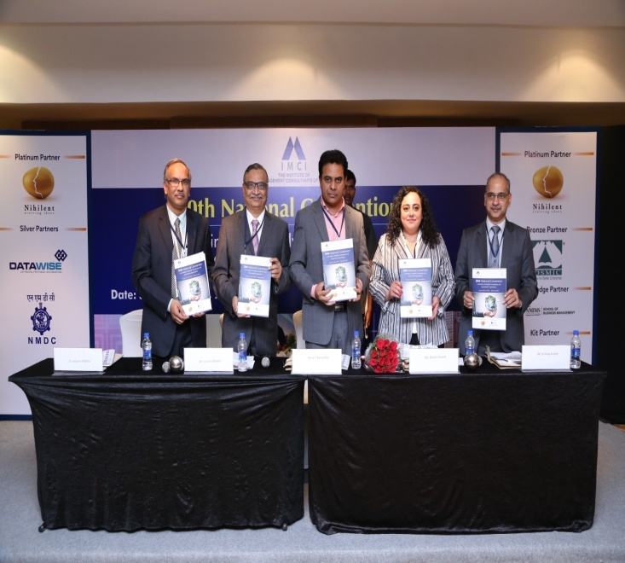
Mr. K T Rama Rao - Hon'ble Minister for IT & Panchayat Raj (Telangana State) delivering a passionate speech on his vision for Telangana
Mr Vinay Kumar honoring Mr. K T Rama Rao
Ms. Reema Nasser - Executive Director, ICMCI (International Council of Management Consulting Institutes) attended the Convention all the way from Jordan, and shared an overview of ICMCI with the delegates
Chief Guest's Address: Mr. K T Rama Rao - Hon'ble Minister for IT & Panchayat Raj (Telangana State)
Unveiling of the 20th IMCI National Convention Souvenir by the dignitaries on the dais

Slide 3
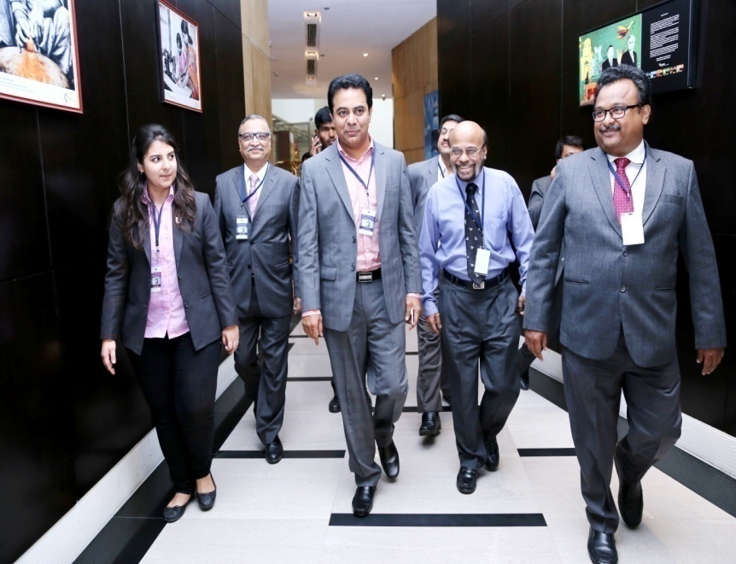
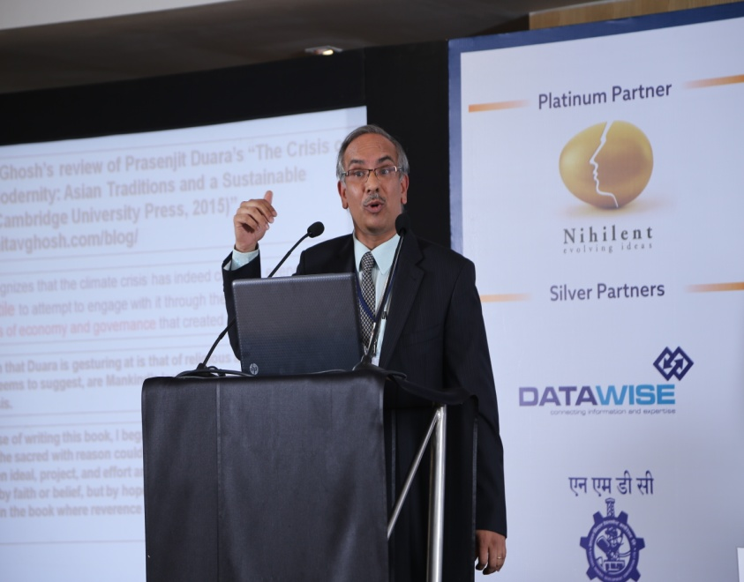
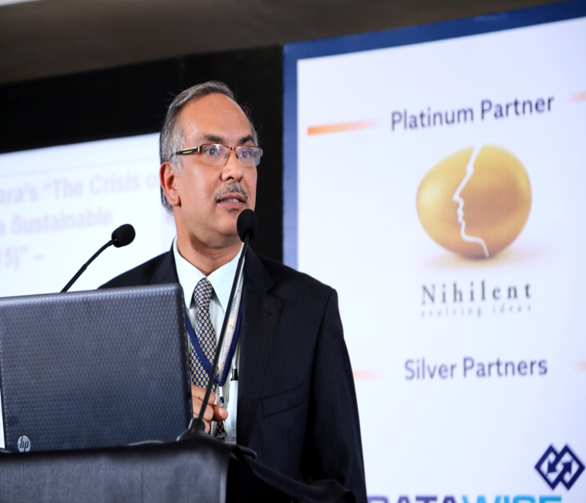
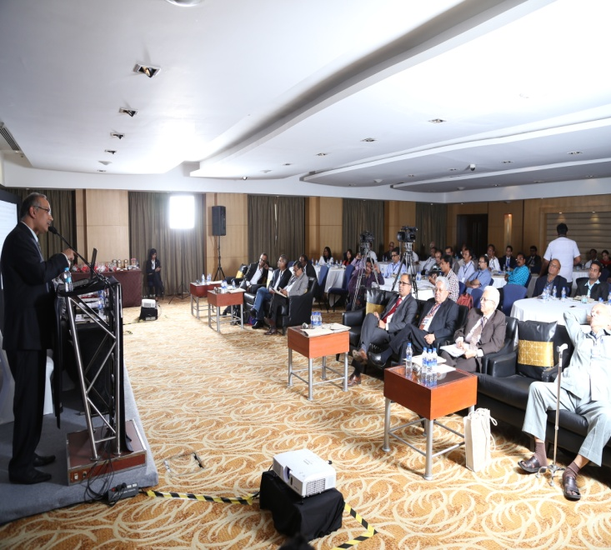
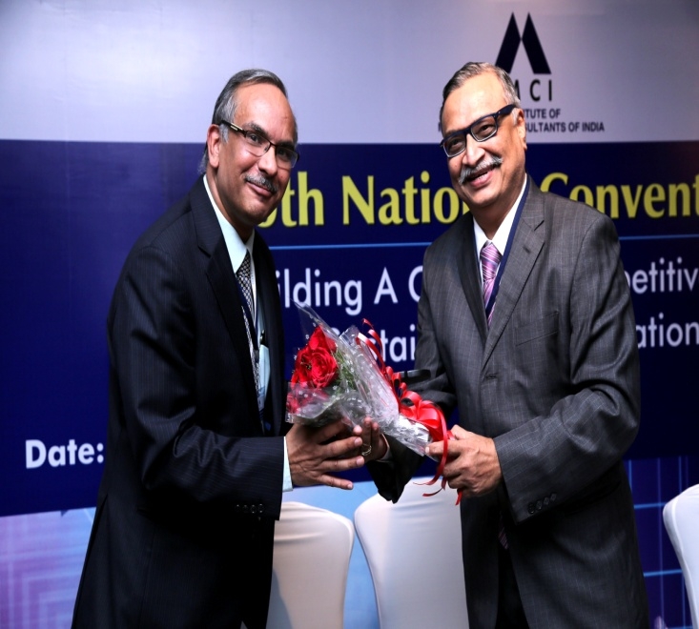
Keynote Address by Dr. Ashwini Mathur - Head Global Clinical Operations India, Novartis
Keynote Address by Dr. Ashwini Mathur - Head Global Clinical Operations India, Novartis
A captivated audience!
Mr K T Rao being accompanied outside after his address
Mr. Suresh Mhatre greeting Dr. Ashwini Mathur with flowers

Slide 4
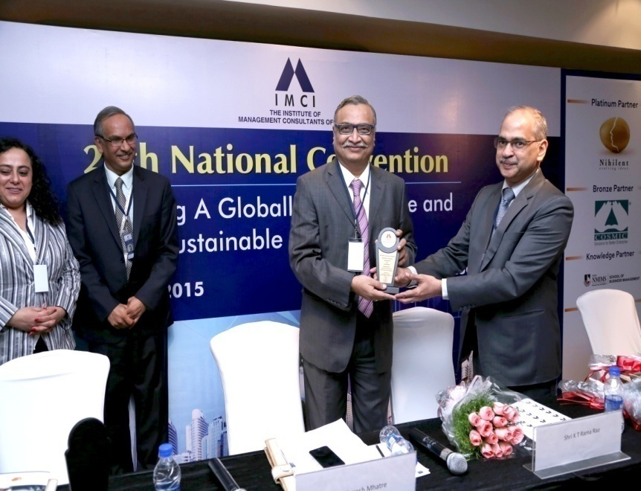
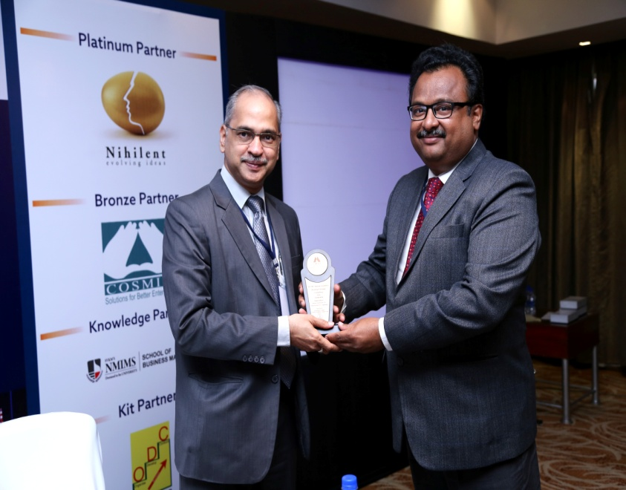
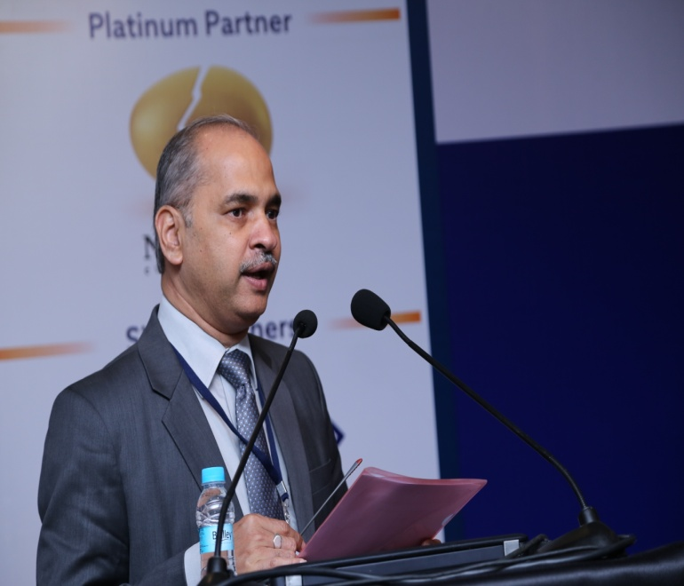
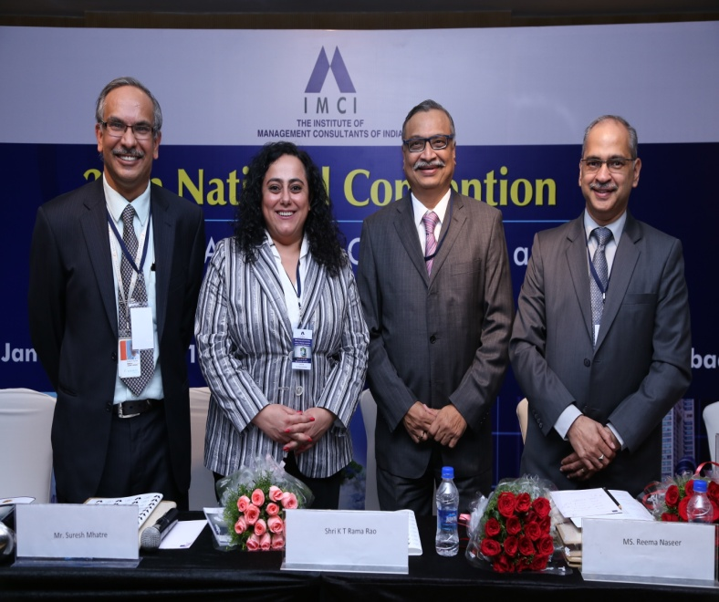
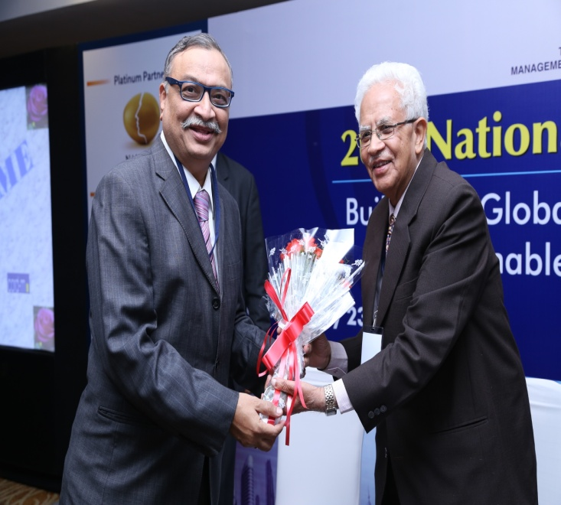
Mr. Vinay Kumar - Chairman, IMCI Hyderabad Chapter, presenting a token of appreciation to Mr. Suresh Mhatre - President, IMCI
Mr. Amar Chegu - Immediate Past Chairman (Hyd) and Convention Committee member presenting a memento to Mr. Vinay Kumar - Chairman, IMCI Hyderabad
Mr. Vinay Kumar - Chairman, IMCI Hyderabad delivering his Vote of Thanks
The dignitaries of the opening session!
Mr. Suresh Mhatre welcoming Mr. V B Gadgil – Chief Executive & Managing Director, L&T Metro

Slide 5
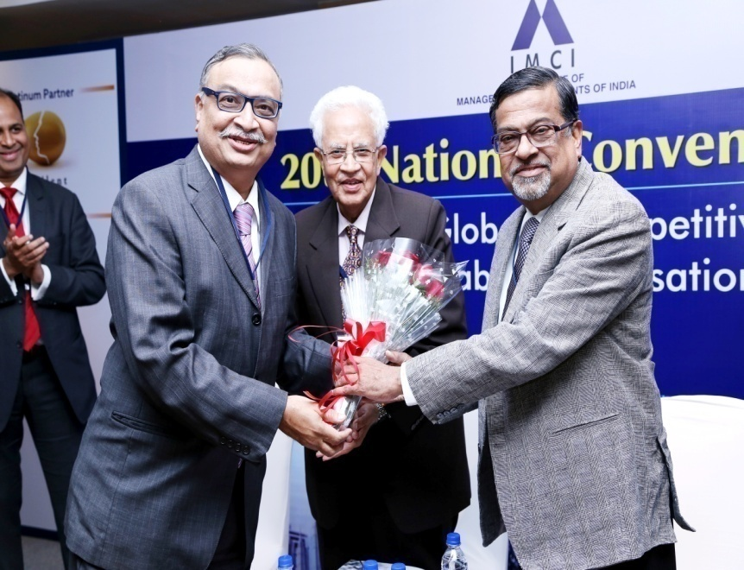
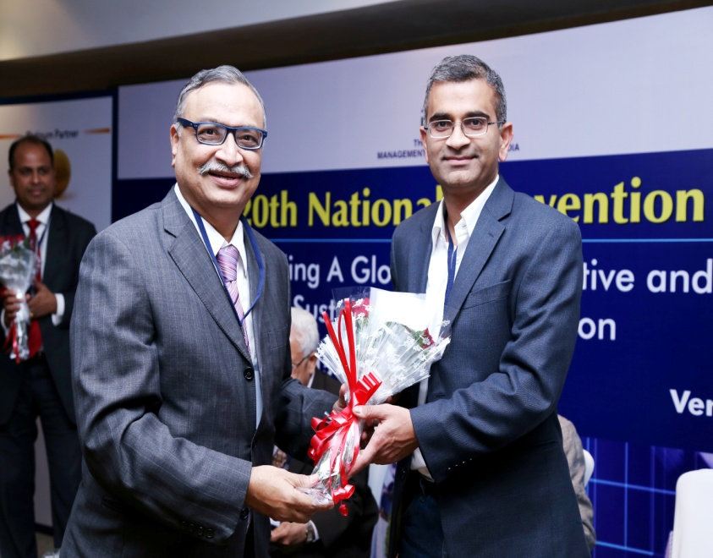
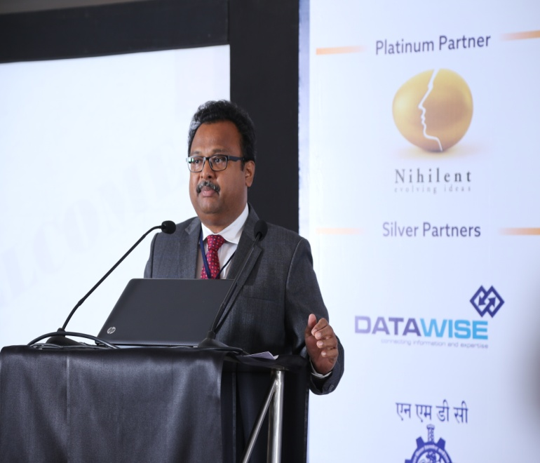
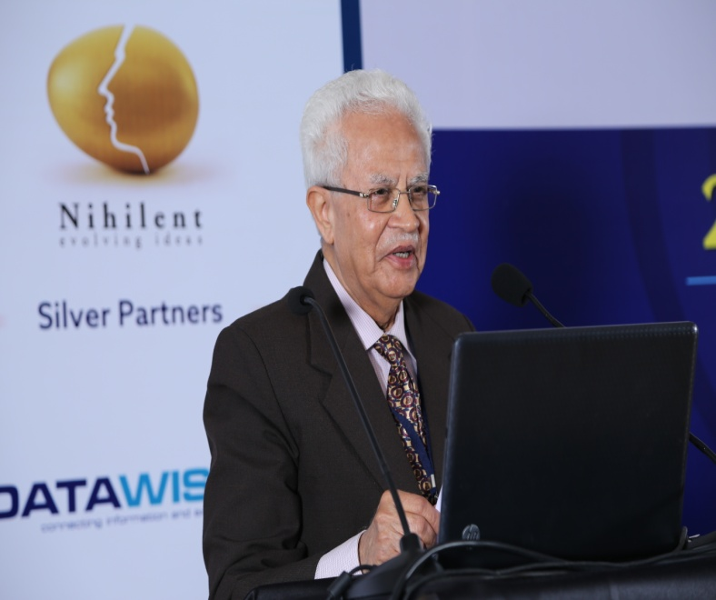
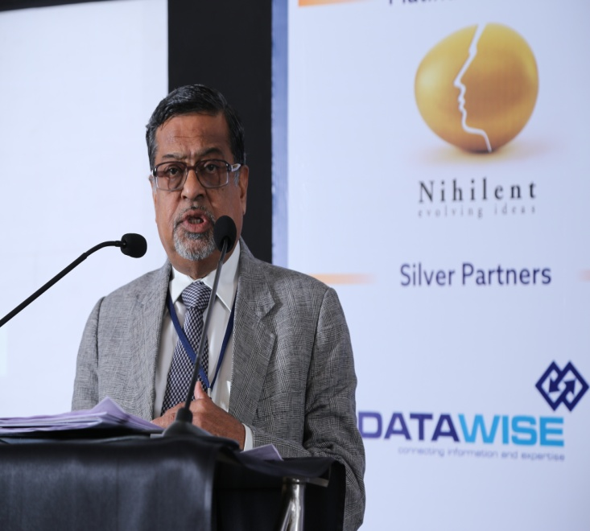
Mr. Suresh Mhatre welcoming Mr. V B Gadgil – Chief Executive & Managing Director, L&T Metro
Mr. Suresh Mhatre welcoming Dr. Venkat Kolluri – Chief Executive Officer, Chitika Inc., USA
Mr. V B Gadgil – Chief Executive & Managing Director, L&T Metro taking forth the discussion on Enabling Intrapreneurship and Innovation.
Mr. Amar Chegu introducing the dignitaries on the dias
Prof (Dr.) B R Virmani – Founder Chairman, Centre for Organization Research & Development in Management (CORD-M) initiating the first panel session on "Enabling Intrapreneurship and Innovation." The session was chaired by Dr. Virmani.

Slide 6
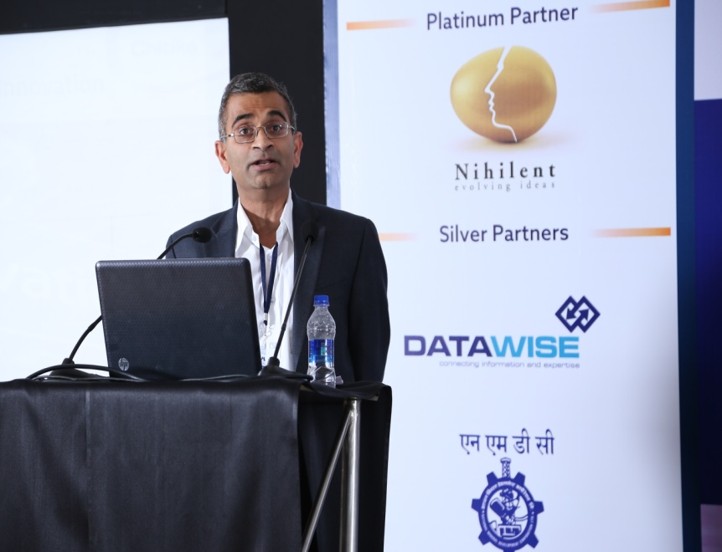
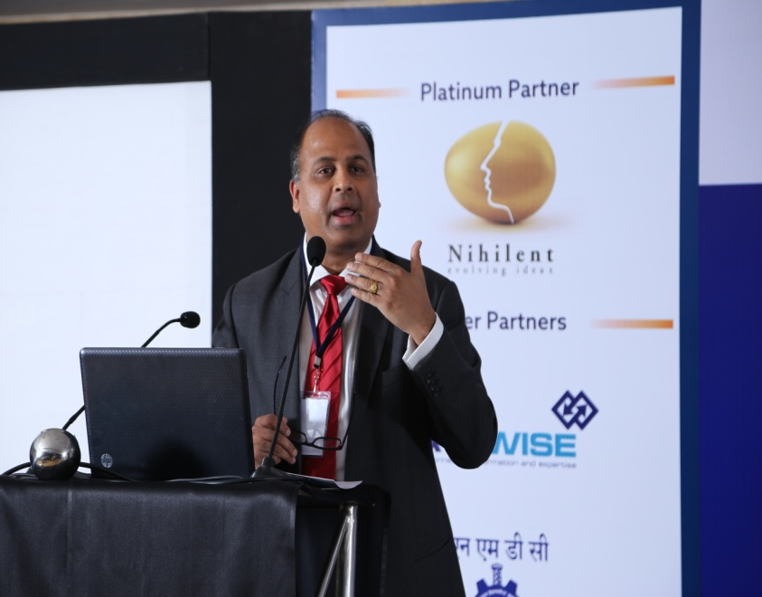
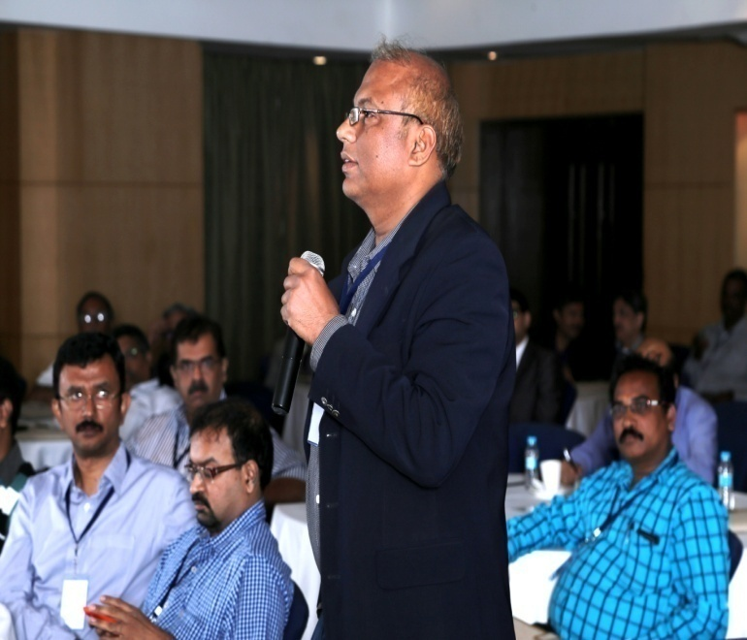
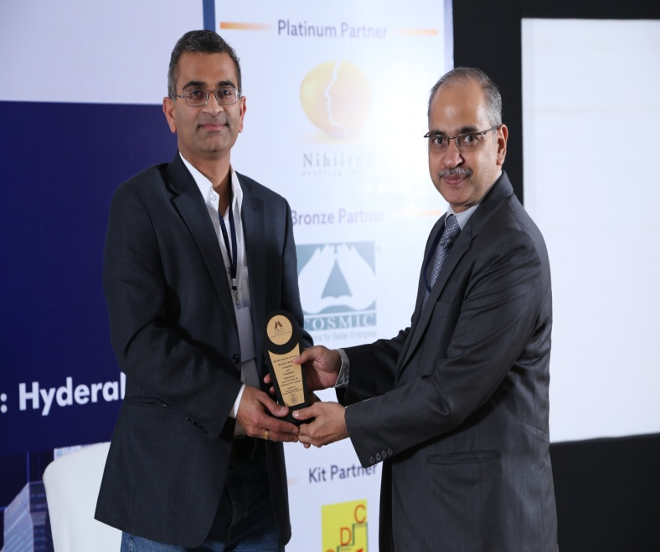
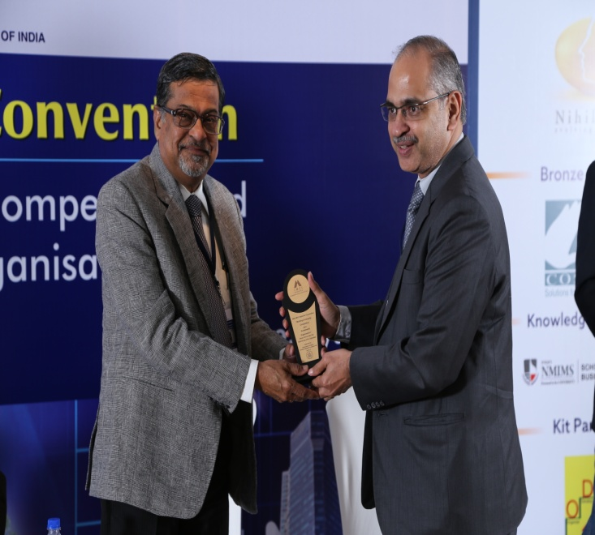
Dr. Venkat Kolluri – Chief Executive Officer, Chitika Inc., USA delivering an animated address on what drives Intrapreneurship and Innovation at Chitika
Mr. B Ravi Teja – Vice President Global Consulting Businesses, Nihilent Technologies taking the stage on Enabling Intrapreneurship and Innovation
The audience loved participating in the interesting discussions
Mr. Vinay Kumar presenting a token of appreciation to Dr. Venkat Kolluri
Mr. Vinay Kumar presenting a token of appreciation to Mr. V B Gadgil

Slide 7
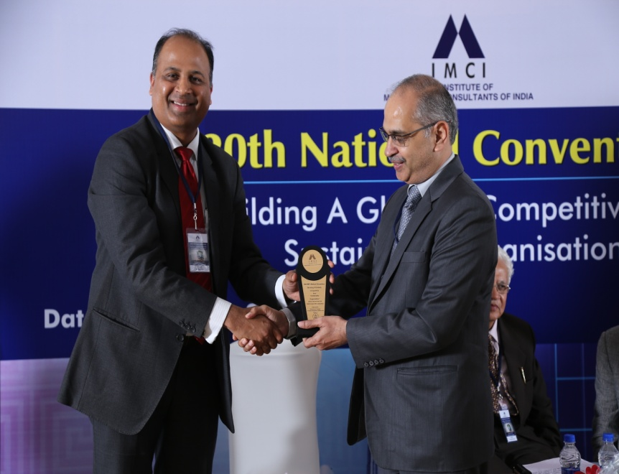
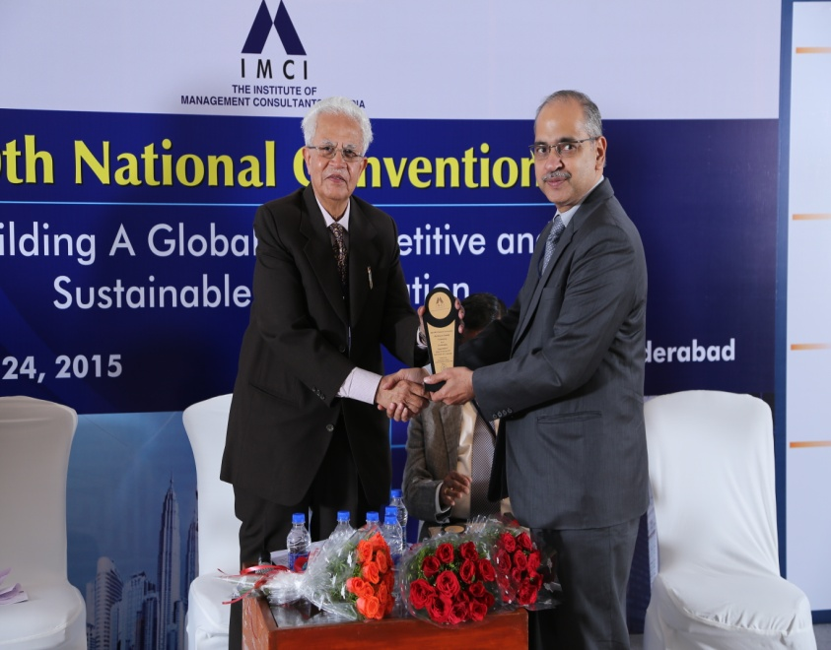
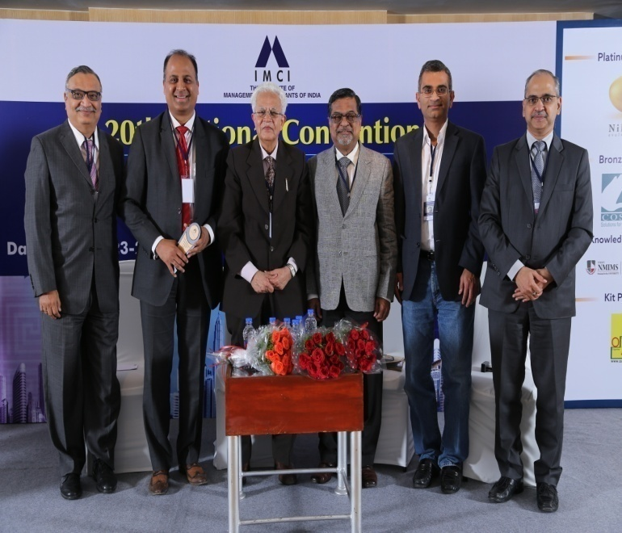
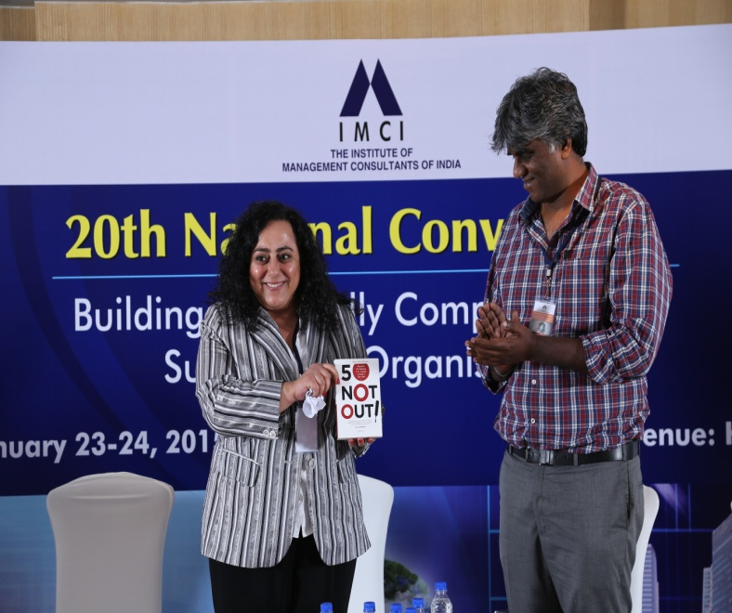
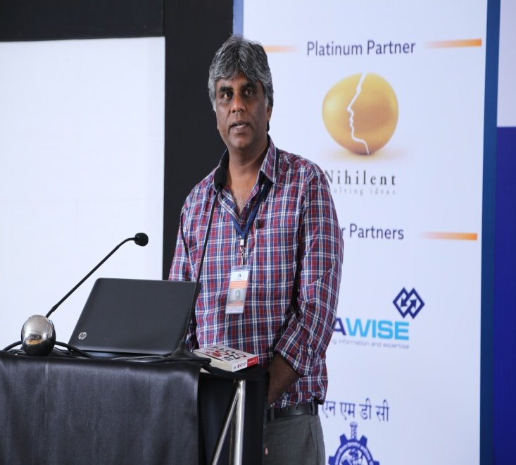
Mr. Vinay Kumar presenting a token of appreciation to Dr. B R Virmani
Release of the book 50 Not Out, penned by member of Hyderabad’s 1986 Ranji Trophy winning squad Harimohan Paruvu, by Ms. Reema Nasser. Mr. Paruvu was present on the occasion for the launch.
Mr. Vinay Kumar presenting a token of appreciation to Mr. B Ravi Teja
The panelists on the dias with Mr. Suresh Mhatre and Mr. Vinay Kumar
Mr. Harimohan Paruvu sharing his thoughts on the new book.

Slide 8
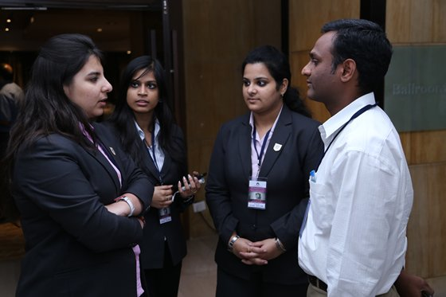
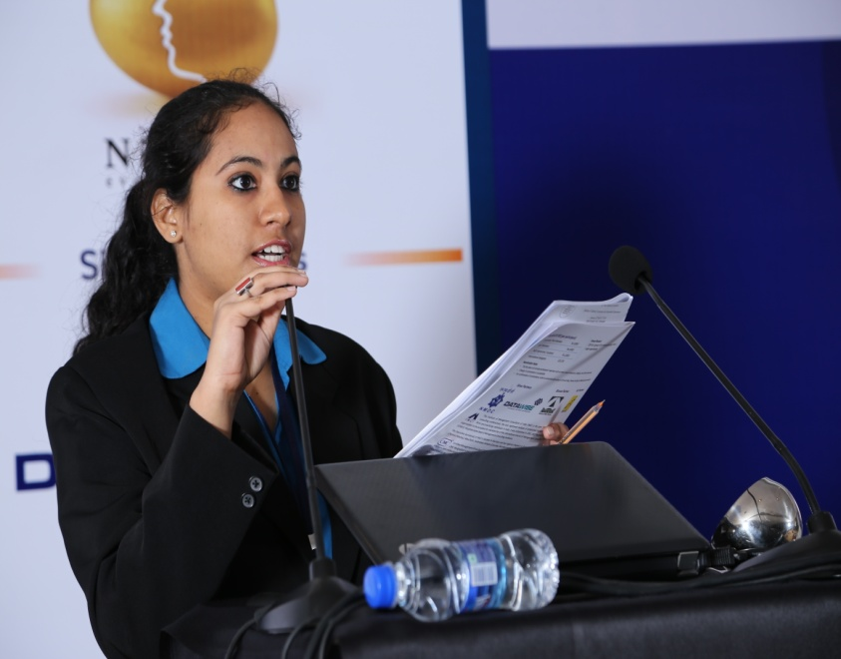
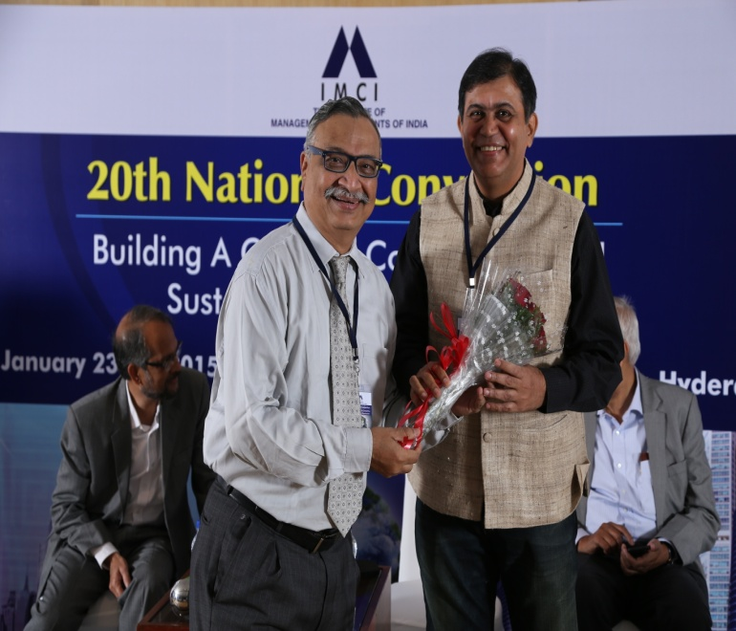
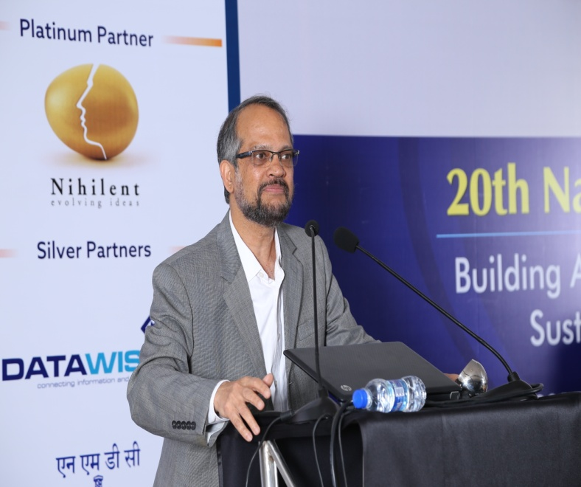
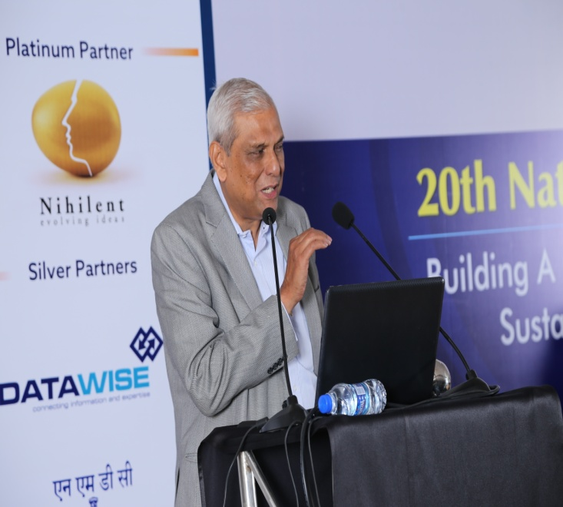
Session Chair - Prof K Ramachandran – Chair of Family Business and Wealth Management, ISB
Student Volunteers from NMIMS, Hyderabad engaging in discussions with a delegate .
The host Ms. Jaswinder Kour
Mr. Suresh Mhatre welcoming Mr. Shashank Sandu – Director, Sandu Pharmaceuticals
Mr. Arun Balakrishnan – Ex -Chairman and Managing Director, HPCL carrying forth the discussion on Leadership and Succession.

Slide 9
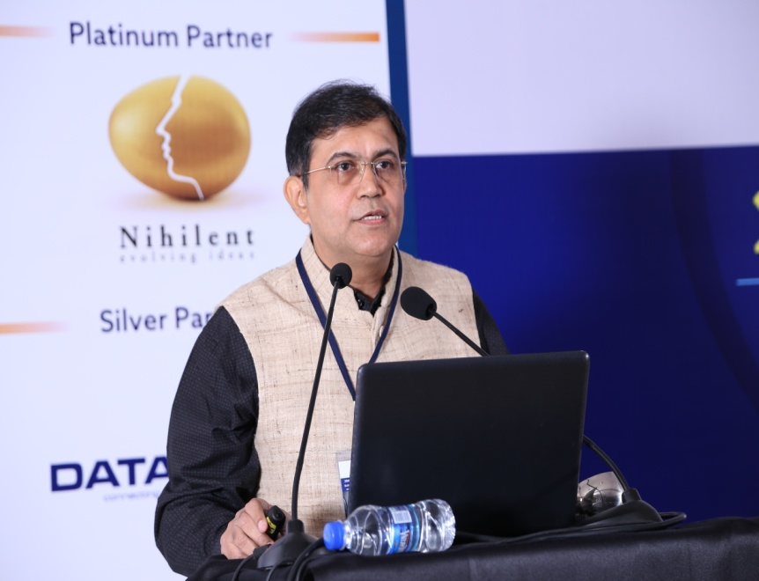
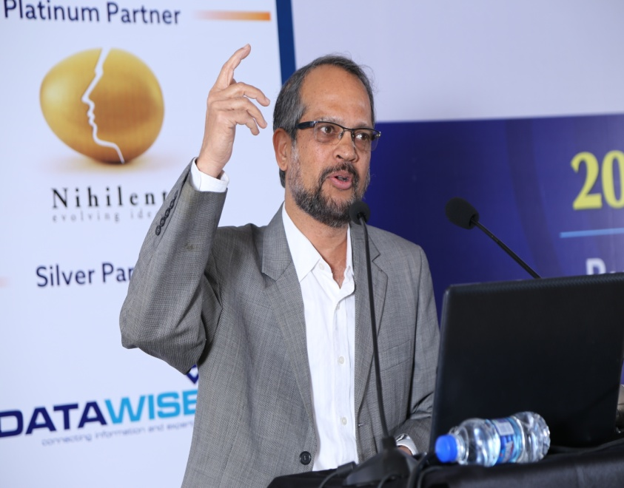
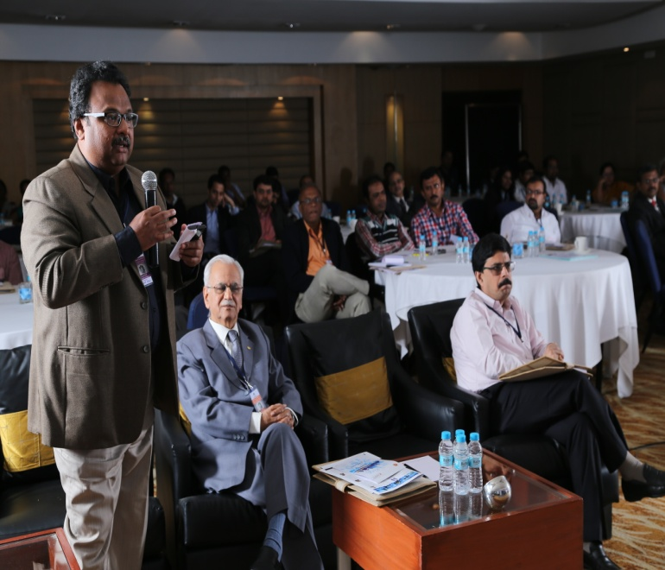
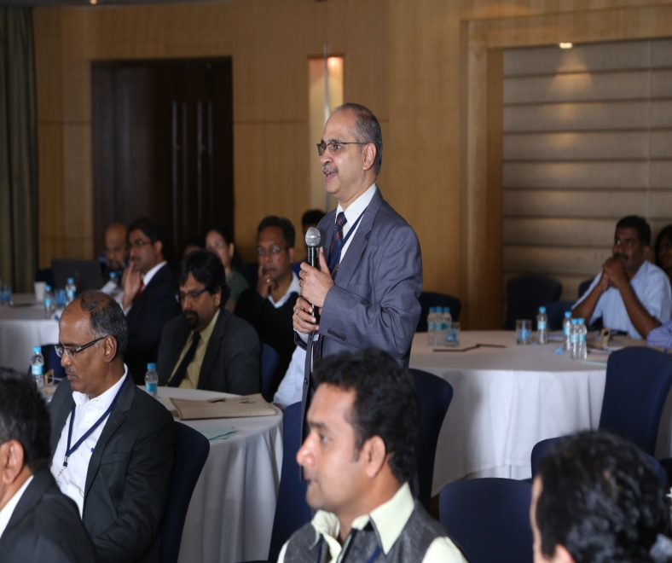
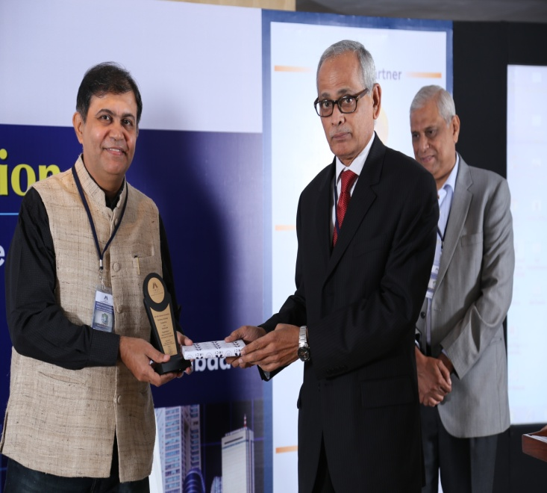
Mr. Vinay Kumar participating in the Q&A rounds
Mr. Shashank Sandu – Director, Sandu Pharmaceuticals takes on stage for Leadership and Succession
Prof K Ramachandran captured the audience with his passionate delivery on the topic of Leadership and Succession
Mr. Amar Chegu participating in the Q&A rounds
Mr. I D Prasad - Member of IMCI Hyderabad Chapter and Convention Committee Member presenting the memento to Mr. Shashank Sandu

Slide 10
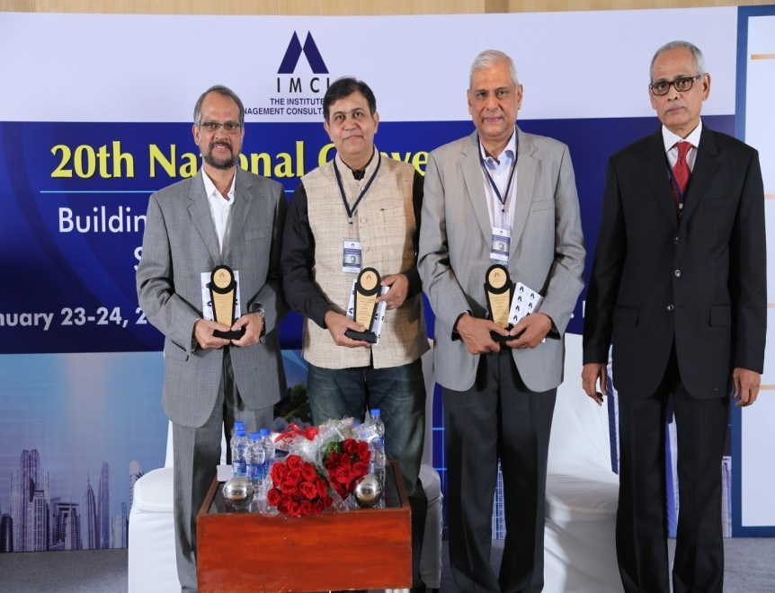
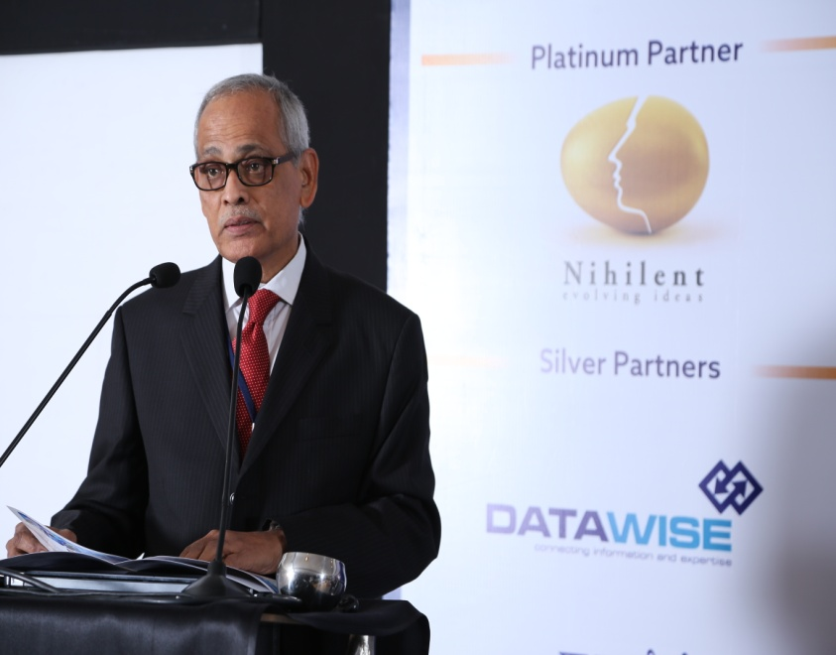
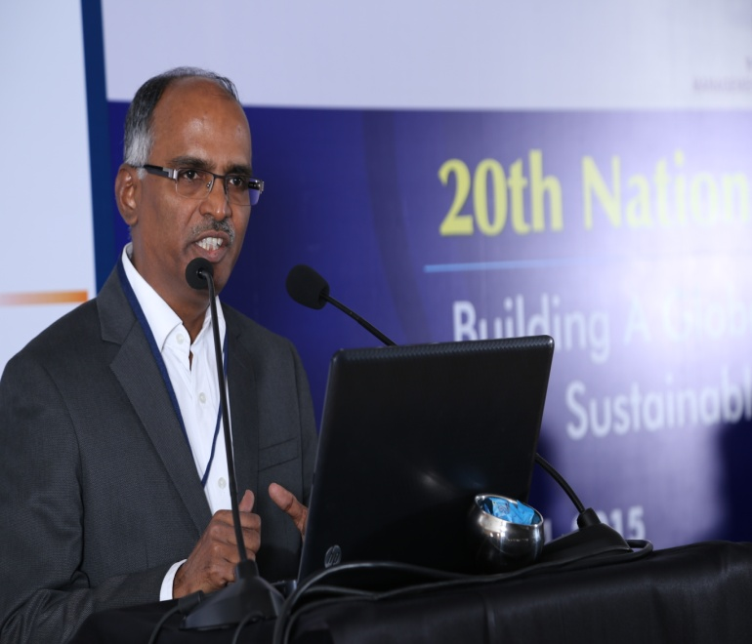
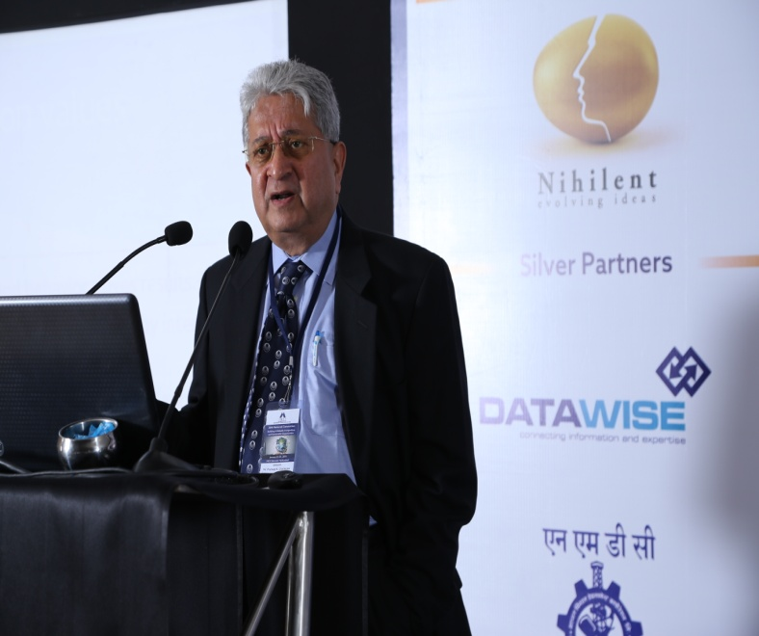
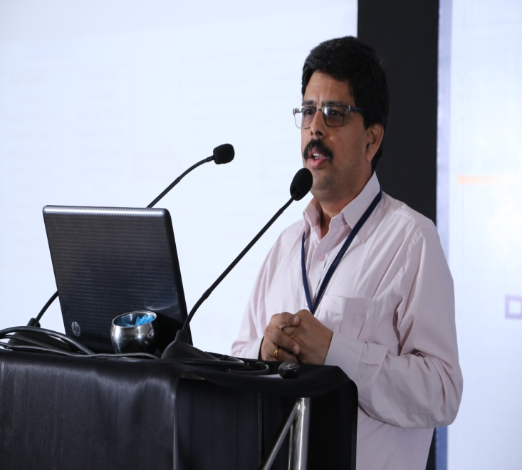
Mr. Pradeep Chatterjee – Director, Chatt Corporate Solutions, Singapore, speaking on Tools for Enhancing Sustainability of Organizations
The dignitaries on the dais along with Mr. I D Prasad
Mr. I D Prasad introducing dignitaries
Mr. Phaneendra Vinnakota - Senior General Manager, National Institute for Smart Government
Mr. K V Rama Mohan – Vice President & Head Business Excellence, Infosys delivers his address on Tools for Enhancing Sustainability of Organizations

Slide 11





Ms. Nalini Marthi - member of IMCI Hyderabad Chapter introducing the dignitaries on the dais
Mr. D Zitendra Rao, member of IMCI Hyderabad Chapter and Convention Committee member participating in the Q&A round
Mr. Shankar Chelluri - member of IMCI Hyderabad Chapter and Convention Committee Member, presenting the token of appreciation to Mr. Feroze Mohammed – Managing Director, Hitachi Consulting Software Services
The panelists on the dais with Mr. Shankar Chelluri
Ms. Jaswinder Kour introducing the theme for the panel session on Skill Development

Slide 12





The panelists enjoying a healthy discussion
Mr. Sharu S Rangnekar, Management Guru, chairing the session on Skill Development
Mr. Amar Chegu presenting on Skill Development on behalf of Capt. Hari Krishna – Head Learning & Leadership Development, All State India
Mr. Syed Azfar Hussain – Head Human Resources, Zensar Technologies, on the topic of Skill Development
Shri M V S Rami Reddy (IAS 1988 UP), Deputy Director General, UIDAI joins the Convention

Slide 13





Mr. Suresh Mhatre presenting the memento to Padma Bhushan awardee Dr. M. B. Athreya - Author, Educationist, and Management Advisor
Shri M V S Rami Reddy (IAS 1988 UP), Deputy Director General, UIDAI addressing the audience
Mr. Sharu S Rangnekar being honoured by Shri M V S Rami Reddy (IAS)
Padma Bhushan awardee Dr. M. B. Athreya Author, Educationist, and Management Guru delivering the Closing Address
Mr. Suresh Mhatre thanking the speakers and delegates

Slide 14





Dr. B R Virmani presenting a certificate of appreciation to Mr. Vinay Kumar
The group with Padma Bhushan awardee Dr. M. B. Athreya, Shri M V S Rami Reddy (IAS), and Management Guru Mr. Sharu Rangnekar
Student Volunteer Swati Ramachandran accepting a certificate of appreciation for her enthusiastic Volunteer work
Mr. Ajay Maurya receives a certificate of appreciation for being a part of the Convention Committee
IMCI Hyderabad Chapter Members along with Ms Reema Nasser and Dr. B Karunakar - Director, NMIMS Hyderabad

